Slide 1
Application of Data Analysis Technology in Sports Prediction
数据挖掘课程论文阅读
2017213854 赵越
2017213867 陈元亮
2017213852 傅滢

Slide 2
Paper 1
Goals: To predict Who will score next? and Who will win? in a game
Models: Based on specific underlying mechanisms for sports scoring dynamics, generate 4 skill-based probabilistic models: (i) independent, (ii) restorative, (iii) independent anti-persistent, and (iv) restorative anti-persistent models
Data set: From four team sports: college-level American football (CFB, 10 seasons; 2000-2009), professional American football (NFL, 10 seasons; 2000-2009), hockey (NHL, 9 seasons; 2000-2003, 2005-2009) and basketball (NBA, 9 seasons; 2002-2010)
Peel L, Clauset A. Predicting Sports Scoring Dynamics with Restoration and Anti-Persistence[C]// IEEE International Conference on Data Mining. IEEE Computer Society, 2015:339-348.
Notes:
For each, we assess model goodness-of-fit by calculating the held out likelihood for each model under a 10-fold cross validation.

Slide 3
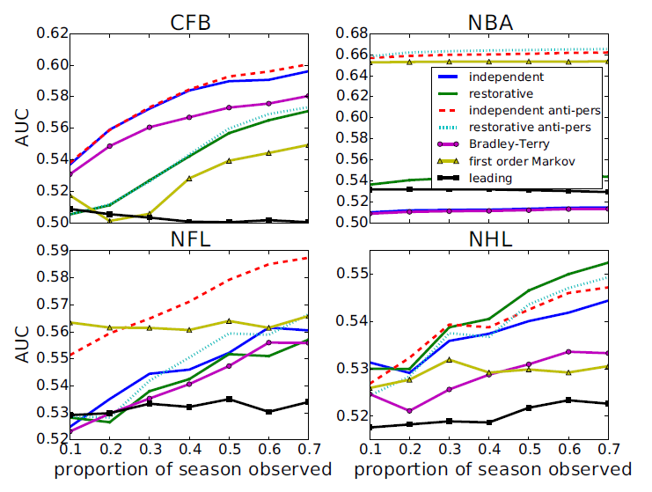
Paper 1
Result 1:
Probability of accurately predicting which team will score next (AUC)
Peel L, Clauset A. Predicting Sports Scoring Dynamics with Restoration and Anti-Persistence[C]// IEEE International Conference on Data Mining. IEEE Computer Society, 2015:339-348.
Notes:
3 baseline models: naive leading model, standard Bradley-Terry model, simple first order Markov model
Based on 95% confidence intervals, our best model performs significantly better than the baseline models for CFB and NBA, and after observing at least half of the season for NFL and NHL.

Slide 4
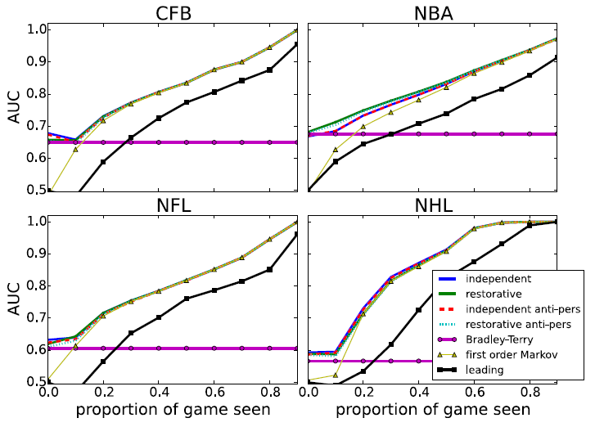
Paper 1
Result 2:
AUC scores for predicting which team will win given the current state of the game
Peel L, Clauset A. Predicting Sports Scoring Dynamics with Restoration and Anti-Persistence[C]// IEEE International Conference on Data Mining. IEEE Computer Society, 2015:339-348.
Notes:
The relatively poorer performance of the “leading” baseline model illustrates that this prediction task is non-trivial—who is leading at a given moment is not as predictive of who wins as knowing something about team skills and scoring
dynamics.
For this task, most of our skill-based models make very similar predictions and the first order Markov model also
performs well. In particular, the first order Markov model performs much worse than the skill-based models at the beginning because it has no information about the heterogeneity of team scoring abilities.

Slide 5
Paper 2
Goals: Simulate the basketball match between two distinct teams as a sequence of team-level play-by-play in-game events
Methodology: Assume the Markov property and model state transitions with a Logistic regression model, extend the model state description to capture the current context in the progression of a game
Data set: Used play-by-play data from 3 regular NBA seasons(seasons 2008/09 to 2010/11)
Extension: The methodology facilitates simple inclusion into any expert system and decision-making process that requires the performance evaluation of teams under various scenarios
Petar Vracar, Erik Štrumbelj, and Igor Kononenko. 2016. Modeling basketball play-by-play data. Expert Systems with Applications 44 (2016), 58 – 66.
Notes:
Using a random walk through a state space whose states represent the in-game events of interest. The main idea of our approach is to extend the state description to capture the current context in the progression of a game. Apart from the in-game event label, the extended state description also includes game time, the points difference, and the opposing teams ‘characteristics. By doing so, the model’s transition probabilities become conditional on a broader game context (and not solely on the current in-game event), which brings several advantages: it provides a means to infer the teams ‘specific behavior in relation to their characteristics, and to mitigate the intrinsic non-homogeneity of the progression of a basketball game (which is especially evident near the end of the game). To simplify the modeling of the transition distribution, we factorize it into terms that can be estimated with separate models.
deal with non-homogeneity of the progression of a basketball game by incorporating relevant variables(time,point difference,…) into the state space of the model.

Slide 6
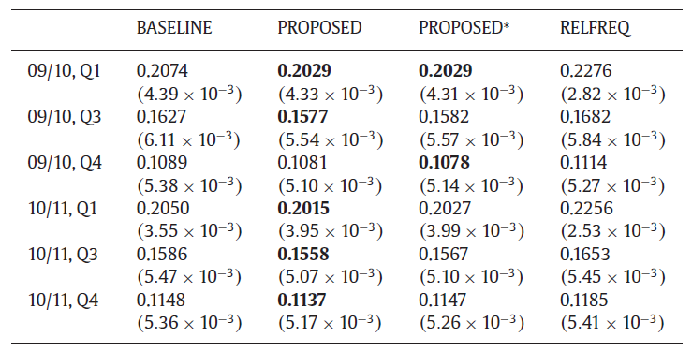
Paper 2
Result :
PROPOSED model is the best forecaster(The best model is shown in bold )
Petar Vracar, Erik Štrumbelj, and Igor Kononenko. 2016. Modeling basketball play-by-play data. Expert Systems with Applications 44 (2016), 58 – 66.
Notes:
We learned all models using the games from one season and evaluated them with respect to how well they can predict the winners of the games in the following season.
Mean Brier score (with standard error in parentheses) for the home team’s win probability forecasts, measured on 2009/10 and 2010/11 NBA regular seasons, starting from the beginning of the game(Q1), from the actual result at the half-time(Q3), and from the actual result at the start of the fourth quarter(Q4). The best model is shown in bold (N = 1190).
PROPOSED model is the best forecaster

Slide 7


Luck is Hard to Beat: The Difficulty of Sports Prediction
Unpredictability cannot be avoided
$$Φ=\frac{S^{2}−σ_{2k}^{2}}{S^{2}}$$
Range:$\left(−∞,1\right]$
Measures the discrepancy between
the random model variance and the
observed variance
Skill
Luck $Φ$
Aoki, R., Assuncao, R. M., & de Melo, P. O. (2017). Luck is Hard to Beat: The Difficulty of Sports Prediction. arXiv preprint arXiv:1706.02447.
Notes:
这篇论文也是讲技能和运气这2个因素对比赛结果的影响,相比于前2篇文章,本文突出的地方在于加入了运气因素用来预测比赛结果,加入运气因素的原因在于体育比赛的不确定性因素难以避免.运气用$Φ$符号表示,公式如….,基本含义[S代表比赛结果历史数据的方差, $σ_{2k}^{2}$表示理想情况下正态分布的方差, $Φ$是2者之间的差除以历史数据的方差,直观上来理解代表2者之间的偏差值],系数的范围是负无穷大到1,用于衡量随机比赛模型和实际比赛模型观察值的差异.[解释S的含义,\sigma的含义,公式计算的过程\含义]
Probabilities are non-negative and add to 1
Soccer example: $P_{h}+P_{t}+P_{a}=1$
Those probabilities are specific for each sport/league/season
$S^{2}$ refers to real variance from real data
$φ^{2}$ refers to complete 正态分布

Slide 8
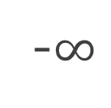
A luck and skill coefficient
-$∞$
0
1
Atypical
Luck
Skill
Close to 1: skill factor has more influence
Close to 0: skill factor has a small influence in the results
Aoki, R., Assuncao, R. M., & de Melo, P. O. (2017). Luck is Hard to Beat: The Difficulty of Sports Prediction. arXiv preprint arXiv:1706.02447.
Notes:
这张图直观的展示了$Φ$的不同取值的含义, $Φ$的值接近1表示技能因素影响比赛结果的程度最高, $Φ$的值接近0表示运气因素影响比赛结果的程度最高, $Φ$的值接近0,从公式看比赛结果接近于正态分布,当$S^{2}=σ_{2k}^{2}$,比赛结果属于完全随机过程.如果重大的异常事件,会导致某一赛季比赛结果异常接近,在理想情况下,S平方接近于0,从而导致$Φ$为负数.
蒙特卡洛随机置信度达到95%,通过一些方法实现随机
Confidence interval(95%) around 0
Monte Carlo simulation considering true the random model hypothesis
Negative values: observed variance is LESS than the expected value under the random model
Monte Carlo simulation considering true the random model hypothesis

Slide 9
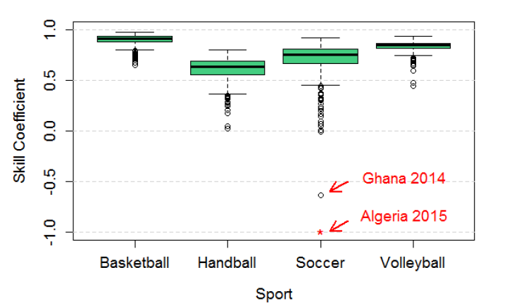
Some results with Ф Coefficient
270713 games
1503 seasons
84 countries
4 Sports
Aoki, R., Assuncao, R. M., & de Melo, P. O. (2017). Luck is Hard to Beat: The Difficulty of Sports Prediction. arXiv preprint arXiv:1706.02447.
Notes:
展示数据集[….本文第一部分研究的1503个赛季, 2007年1月至2016年7月共发生198个联赛270713场比赛。比赛发生在来自美国，欧洲，亚洲，非洲和大洋洲的84个国家。]
$Φ$值越接近下限0，越接近随机模型，越接近上限1,表示离随机结果越远,表明技能因素主要影响着比赛结果。该论文比较了4个不同运动领域运气和技能因素的影响,对篮球和排球运动来说技能因素占主导因素,而在足球和手球运动中运气占运气因素,直观理解篮球的排球一场比赛得分很高疯狂进球,而足球和手球比赛中往往1到2个球就能改变比赛结果。
在图上有2个异常点,出现的原因是这两年加纳和阿尔及利亚足球联赛出现了球员伤亡的事件,导致整个赛季的比赛结果异常,各个球队的比赛结果非常接近,S的方差非常小,所以运气$Φ$小于0

Slide 10
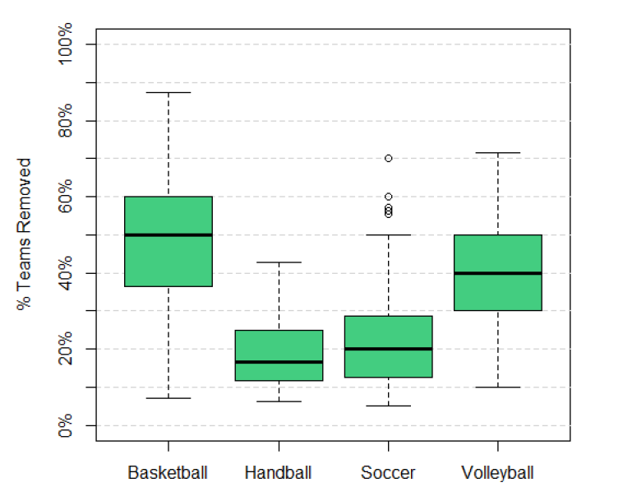
How many teams should be removed to make it random?
Aoki, R., Assuncao, R. M., & de Melo, P. O. (2017). Luck is Hard to Beat: The Difficulty of Sports Prediction. arXiv preprint arXiv:1706.02447.
Notes:
之后做了请外一个实验,对于这4项运动,在每项运动中有挑选的删除一些球队,来使得这项运动的比赛结果称为一个纯随机的结果,例如篮球需要删除50%的球队,排球需要删除40%,手球和足球需要删除20%的球队,这一结果很好的揭示了上一张图片的结果,篮球和排球运动来说技能因素占主导因素,而在足球和手球运动中运气占运气因素

Slide 11
Conclusion
Contribution
Ф coefficient
Which leagues and sports are more competitive
Bayesian model
Which features have more influence on the skill
Aoki, R., Assuncao, R. M., & de Melo, P. O. (2017). Luck is Hard to Beat: The Difficulty of Sports Prediction. arXiv preprint arXiv:1706.02447.

Slide 12
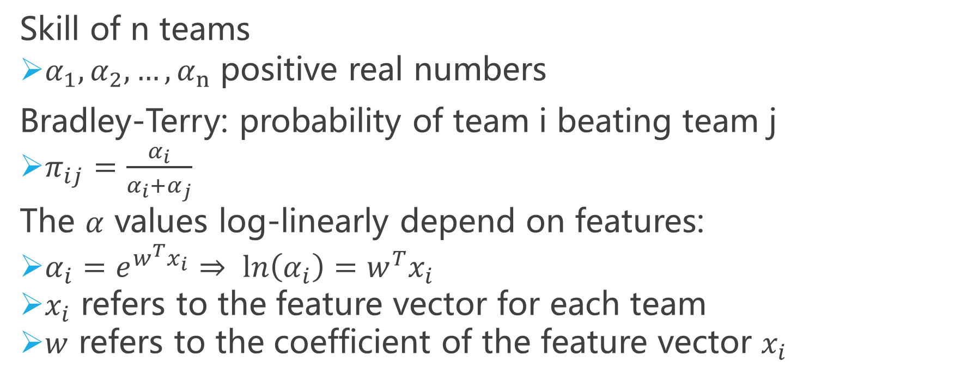
附录: Skill estimation
Skill of n teams
$α_{1},α_{2},…,α_{n}$ positive real numbers
Bradley-Terry: probability of team i beating team j
$π_{ij}=\frac{α_{i}}{α_{i}+α_{j}}$
The $α$ values log-linearly depend on features:
$α_{i}=e^{w^{T}x_{i}}⇒ ln\left(α_{i}\right)=w^{T}x_{i}$
$x_{i}$ refers to the feature vector for each team
$w$ refers to the coefficient of the feature vector $x_{i}$
Aoki, R., Assuncao, R. M., & de Melo, P. O. (2017). Luck is Hard to Beat: The Difficulty of Sports Prediction. arXiv preprint arXiv:1706.02447.
Notes:
球队技能评价模型,扩展Bradley-Terry模型,把主队与客队的得分视为主队与客队的胜利概率,由此得到主队击败客队的胜利概率,N_k(例如篮球比赛的得分)很大而Y_k的概率很小,所以用泊松分布近似二项分布,将泊松分布中的$λ$替换成比赛总得分+Bradley-Terry模型+一个随机因子
Skill estimation
Probabilities Graphical Model
Seasons/Leagues with significantly different of 0 and positive
Skill component is decomposed into explanatory features
Only basketball, NBA

Slide 13
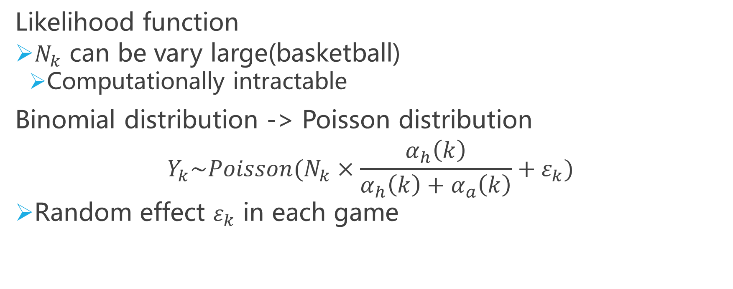
附录: Skill estimation
Likelihood function
$N_{k}$ can be vary large(basketball)
Computationally intractable
Binomial distribution -> Poisson distribution
$$Y_{k}\sim Poisson(N_{k}×\frac{α_{h}\left(k\right)}{α_{h}\left(k\right)+α_{a}\left(k\right)}+ε_{k})$$
Random effect $ε_{k}$ in each game
Aoki, R., Assuncao, R. M., & de Melo, P. O. (2017). Luck is Hard to Beat: The Difficulty of Sports Prediction. arXiv preprint arXiv:1706.02447.
Notes:
球队技能评价模型,扩展Bradley-Terry模型,把主队与客队的得分视为主队与客队的胜利概率,由此得到主队击败客队的胜利概率,会出现 $N_{k}$(例如篮球比赛的得分)点的数量非常多,计算上难以处理,所以用泊松分布近似二项分布,将泊松分布中的$λ$参数替换成比赛总得分+Bradley-Terry模型+一个随机因子
Skill estimation
Probabilities Graphical Model
Seasons/Leagues with significantly different of 0 and positive
Skill component is decomposed into explanatory features
Only basketball, NBA

Slide 14
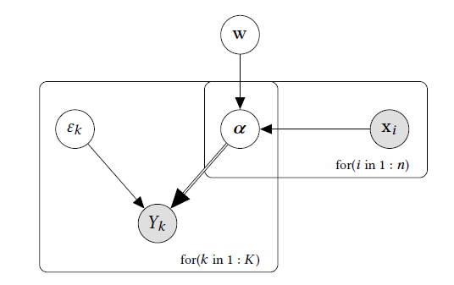
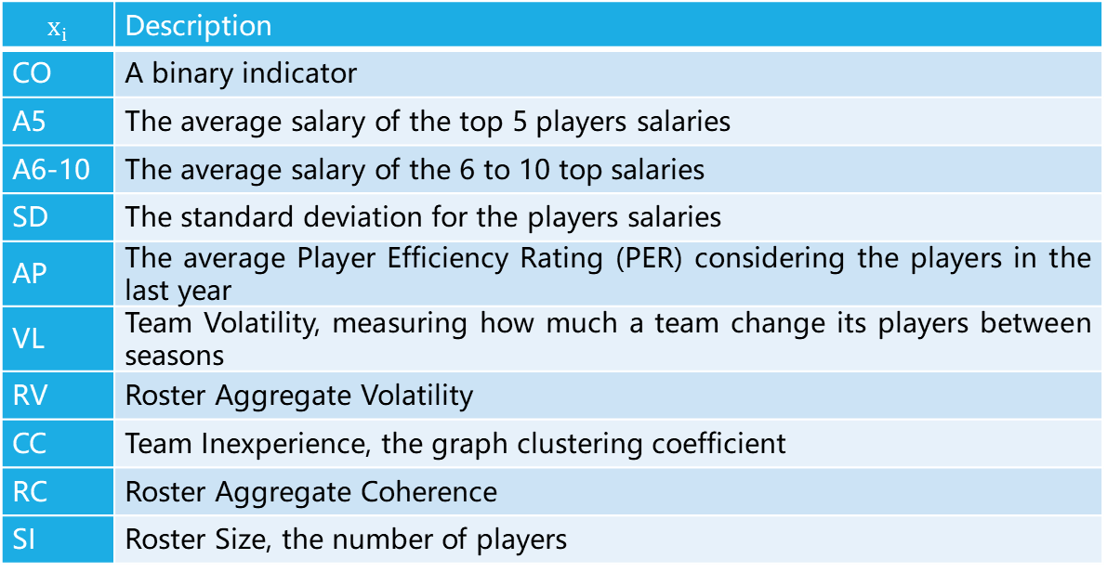
附录: Skill estimation
:(可以改进的点,使用贝叶斯神经网络求解w)
$$x_{i}$$ | Description
CO | A binary indicator
A5 | The average salary of the top 5 players salaries
A6-10 | The average salary of the 6 to 10 top salaries
SD | The standard deviation for the players salaries
AP | The average Player Efficiency Rating (PER) considering the players in the last year
VL | Team Volatility, measuring how much a team change its players between seasons
RV | Roster Aggregate Volatility
CC | Team Inexperience, the graph clustering coefficient
RC | Roster Aggregate Coherence
SI | Roster Size, the number of players
Probabilistic Graphical Model for the Bayesian skills model. The number of teams is n and K is the total number of matches in the season.
Aoki, R., Assuncao, R. M., & de Melo, P. O. (2017). Luck is Hard to Beat: The Difficulty of Sports Prediction. arXiv preprint arXiv:1706.02447.
Notes:
通过NBA各个赛季的历史比赛数据,可以得到每场比赛的总得分$N_{k}$和主队的得分$Y_{k}$,将每个赛季$Y_{k}$的分布拟合为泊松分布,可以得到泊松分布的参数$λ$,而根据之前的推导$λ\text{=}N_{k}×\frac{α_{h}\left(k\right)}{α_{h}\left(k\right)+α_{a}\left(k\right)}+ε_{k}$,此公式中的主队的实力$α_{i}$和随机因子$ε_{k}$可以通过求解得到,而$α_{i}=e^{w^{T}x_{i}}$,而每支球的技能特征向量$x_{i}$如右表所示,右侧表格显示了为了表示NBA球队的技能所选取的维度$x_{i}$的具体解释,具体的维度例如CO表示球队位于西部还是东部,A5表示前五名球员平均薪水,A6-10表示6到10名最高工资球员的平均工资,SD表示球员工资的标准差,AP表示去年球员的平均球员效率等级,VL表示球队的人员变化程度,RV表示球队的转会变化程度,CC表示球队的经验,RC表示球员之间的关系,SI表示球员人数,可以通过矩阵的运算求出$w$向量的值,从而得到球队的各个技能对应的系数,用于球队实力和胜率的预测,以上是球队技能部分概率图模型的解释. :(可以改进的点,使用贝叶斯神经网络求解w)

Slide 15
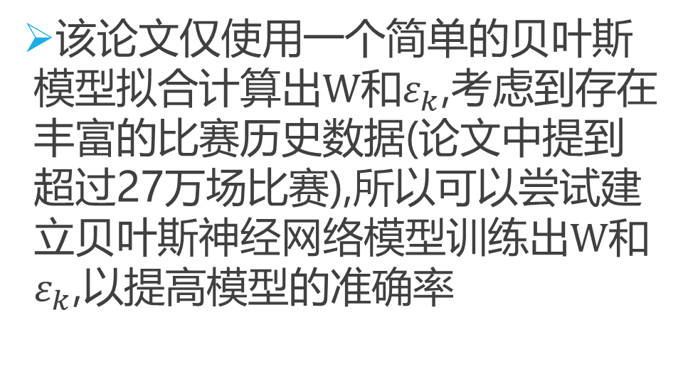
附录: Skill estimation Improvement
该论文仅使用一个简单的贝叶斯模型拟合计算出$W$和$ε_{k}$,考虑到存在丰富的比赛历史数据(论文中提到超过27万场比赛),所以可以尝试建立贝叶斯神经网络模型训练出$W$和$ε_{k}$,以提高模型的准确率
Probabilistic Graphical Model for the Bayesian skills model. The number of teams is n and K is the total number of matches in the season.

Slide 16

附录: Predicting matchups and preferences in context
features of objects
$$\operatorname{Pr}\left(a beats b\right)=\frac{n_{a}+1}{n_{a}+n_{b}+1}$$
$$γ_{a}=W^{T}X_{a}$$
features of the context
$$a_{blade}\left(x_{a},z_{g}\right)=f\left(B^{′}z_{g}\right)∘f\left(Bx_{a}\right)$$
$$b_{blade}\left(x_{b},z_{g}\right)=f\left(B^{′}z_{g}\right)∘f(Bx_{b})$$
$$a_{chest}\left(x_{a},z_{g}\right)=f\left(C^{′}z_{g}\right)∘f(Cx_{a})$$
$$b_{chest}\left(x_{b},z_{g}\right)=f\left(C^{′}z_{g}\right)∘f(Cx_{b})$$
Pipeline of SPLIT model
Shuo Chen and Thorsten Joachims. 2016. Predicting matchups and preferences in context. In Proceedings of the 22nd ACM SIGKDD International Conference on Knowledge Discovery and Data Mining. ACM, ACM, USA, 775–784.
Notes:
该论文针对任意一对一的比赛,预测比赛结果,通过使用比赛对象的特征(features of objects)和比赛环境/场外因素(features of the context)的特征,通过将这2个维度的特征结合来预测比赛结果.与Luck is Hard to Beat: The Difficulty of Sports Prediction这篇文章的相同点在于,都使用了Bradley-Terry模型和比赛对象的特征(features of objects)来评估一个选手或一个球队的技能得分.但不同之处在于Luck is Hard to Beat: The Difficulty of Sports Prediction使用了贝叶斯模型计算技能得分.
除此之外对于场外因素维度,而Predicting matchups and preferences in context这篇文章除了技能维度之外,针对不同领域选取了场外因素(例如天气)作为特征, 而Luck is Hard to Beat: The Difficulty of Sports Prediction提出了运气这一概念,通过运气的值代表场外因素的影响.

Slide 17
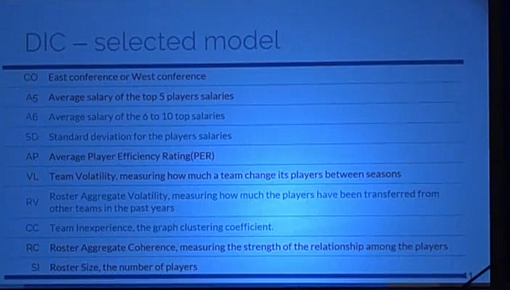
DIC-selected model

Slide 18
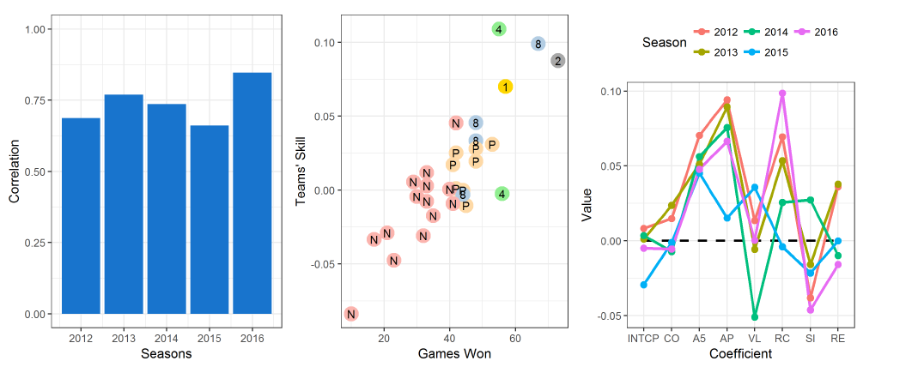

Slide 19
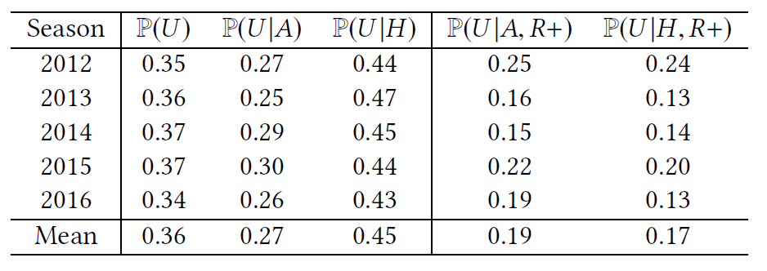
When the underdog plays at home, its winning probability increase 0.18
This effect disappears if playing against the best ones

Slide 20
Management strategy
Building smaller teams allow for higher salaries
It also increase the odds of attracting high PER players and increasing rapport(roster aggregate coherence)
Smaller, more cohesive teams have less conflicts and are easier to manage

Slide 21
Attractive area
Relatively isolated system seen repeatedly
Many datasets available
Popularity
Economic Relevance
Notes:
84个国家的1503个赛季的198个联赛4种不同的运动：篮球，足球，排球和手球

Slide 22
Related Work

Slide 23
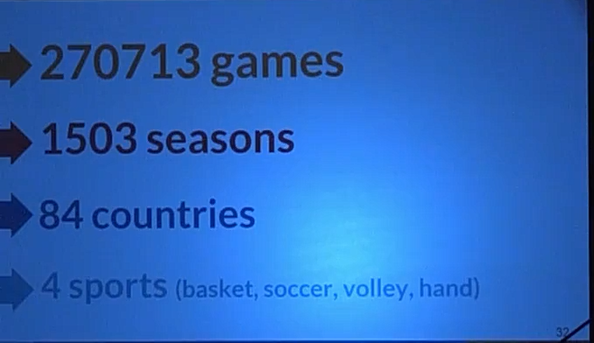

Slide 24
Goals & Methods
Evaluate the luck and skill influence in sports leagues
Skill influence -> Ф coefficicent
Significant test
Which teams should be removed to make a league random
Estimate the teams' skill
Teams' skill in a season/league
What explains skill?

Slide 25
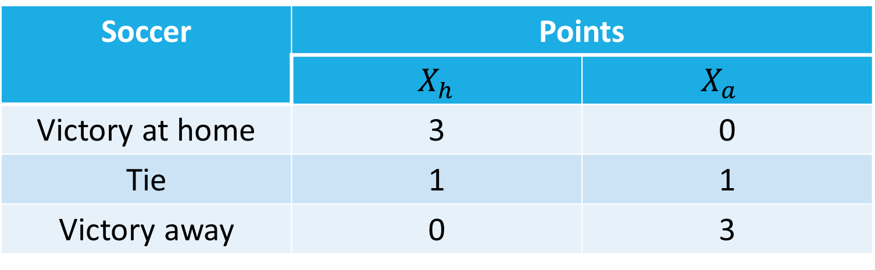
A luck and skill coefficient
For soccer:
Soccer | Points
 | $X_{h}$ | $$X_{a}$$
Victory at home | 3 | 0
Tie | 1 | 1
Victory away | 0 | 3

Slide 26
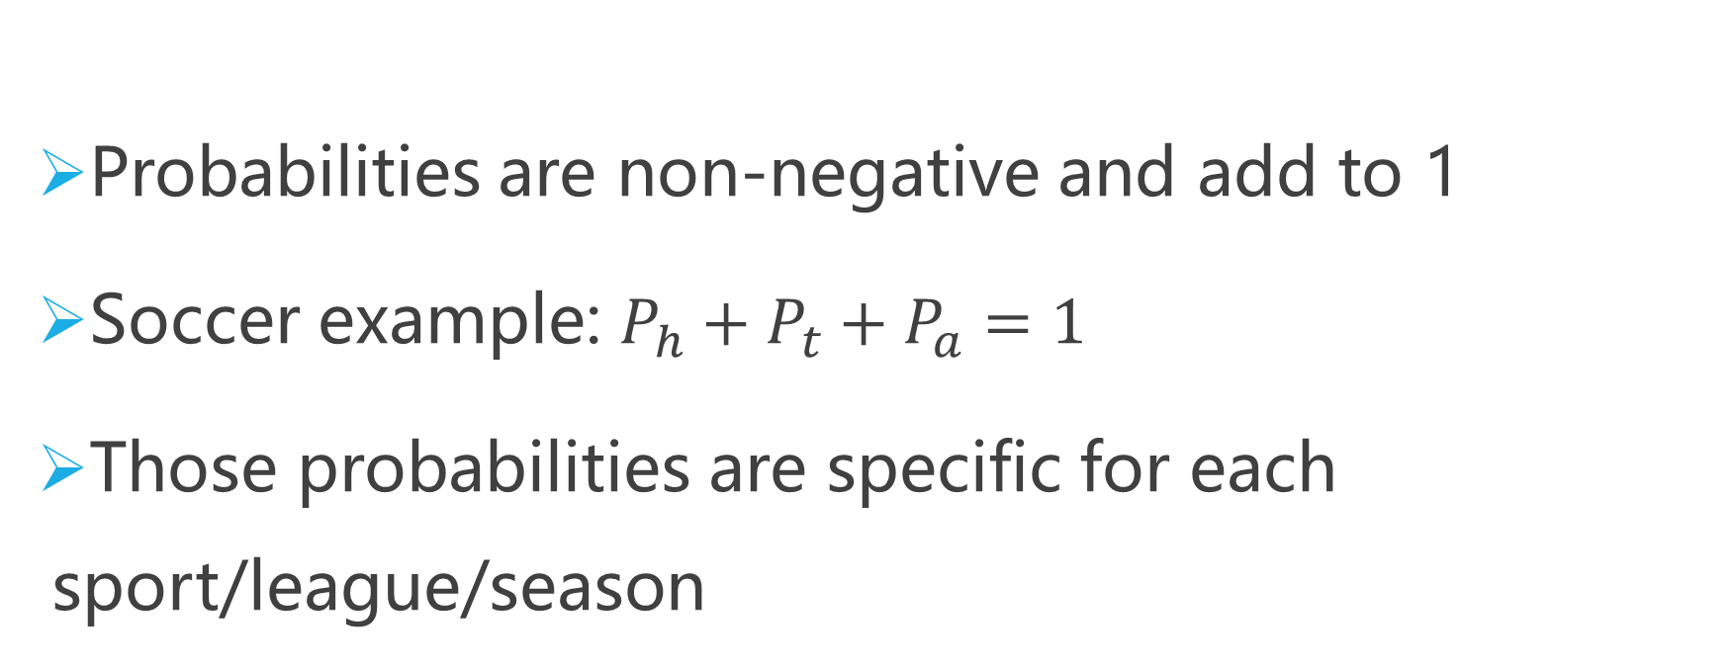
A luck and skill coefficient
Probabilities are non-negative and add to 1
Soccer example: $P_{h}+P_{t}+P_{a}=1$
Those probabilities are specific for each sport/league/season
Notes:
概率->期望->

Slide 27
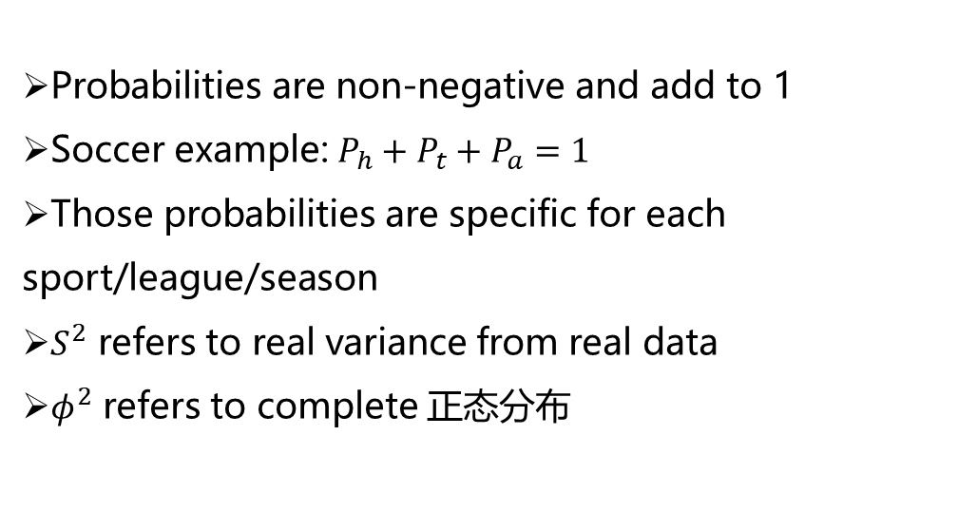
A luck and skill coefficient
Probabilities are non-negative and add to 1
Soccer example: $P_{h}+P_{t}+P_{a}=1$
Those probabilities are specific for each sport/league/season
$S^{2}$ refers to real variance from real data
$φ^{2}$ refers to complete 正态分布

Slide 28
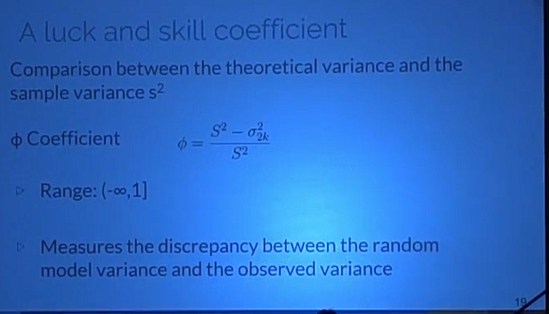
A luck and skill coefficient

Slide 29
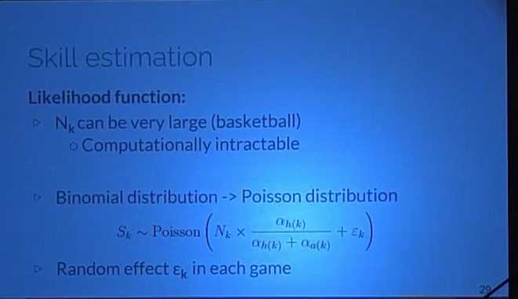
Skill estimation
Likelihood function:
Notes:
Likelihood function:
Games final score
K games and $n$ teams
$N_{k }$: total points of each team
$S_{k}$: points of the home team
$N_{k }$is a sequence of success and failures
$S_{k }$~ Binomial Distribution conditioned in $N_{k }$

Slide 30
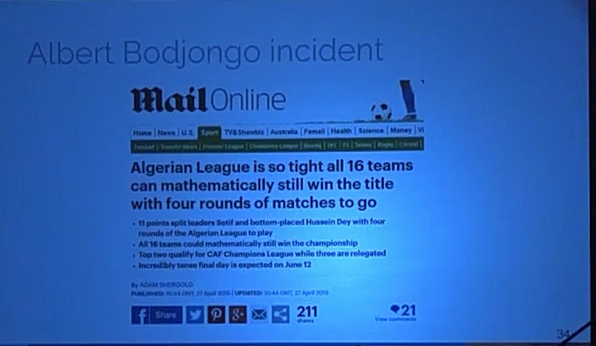
Albert Bodjongo incident

Slide 31
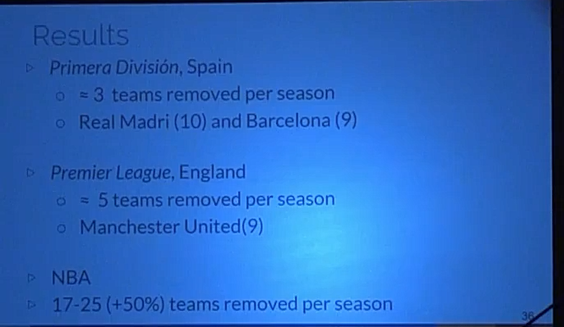
Results

Slide 32
Skill estimation
Probabilities Graphical Model
Seasons/Leagues with significantly different of 0 and positive
Skill component is decomposed into explanatory features
Only basketball, NBA

Slide 33
Dados
League
National Basketball Association(NBA)
Regular Season: round-robin system(=1230 matches)
Playoffs: 16 teams

Slide 34
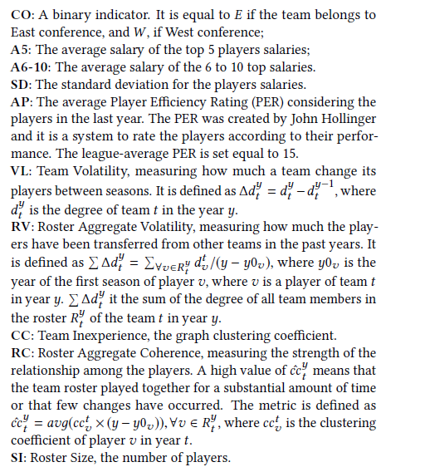
Features

Slide 35


Skill estimation
Likelihood function:
Games final score
K games and $n$ teams
$N_{k }$: total points of each team
$S_{k}$: points of the home team
$N_{k }$is a sequence of success and failures
$S_{k }$~ Binomial Distribution conditioned in $N_{k }$

Slide 36
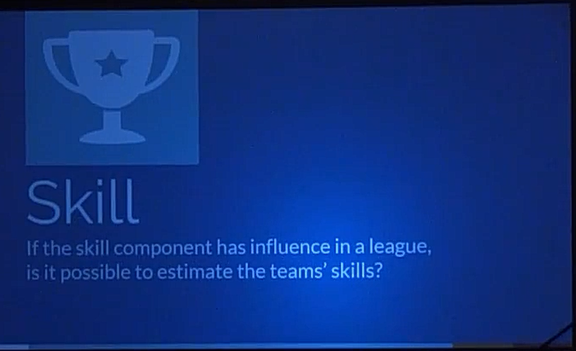

Slide 37
Results
Ф Coefficient

Slide 38
A luck and skill coefficient
-$∞$
0
1
Atypical
Luck
Skill
Close to 0: skill factor has a small influence in the results

Slide 39
A luck and skill coefficient
-$∞$
0
1
Atypical
Luck
Skill
Negative values: observed variance is LESS than the expected value under the random model

Slide 40

A luck and skill coefficient
Confidence interval(95%) around 0
-$∞$
0
1
Atypical
Luck
Skill
Monte Carlo simulation considering true the random model hypothesis

Slide 41
A luck and skill coefficient
If Ф is significantly different from 0,
how many teams should be removed from a league in order to turn it random?
By repeated simulation

Slide 42
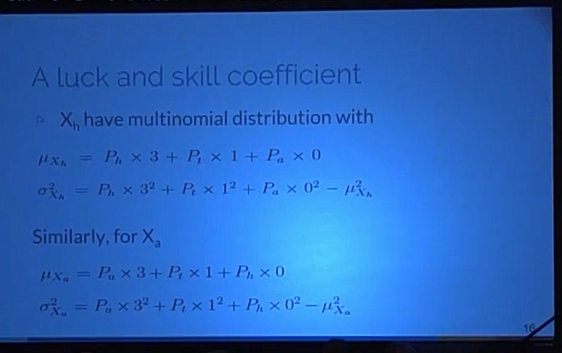
A luck and skill coefficient

Slide 43
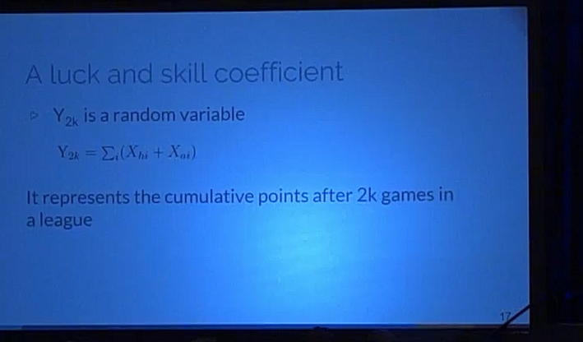
A luck and skill coefficient

Slide 44
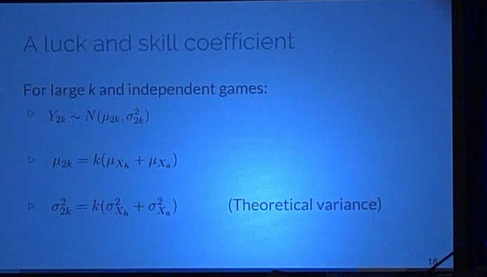
A luck and skill coefficient

Slide 45
Disentangling luck and skill

Slide 46
A luck and skill coefficient
Leagues considered
Teams with the same number of games
Each team plays twice against all others, once at home
The final result is total number of points accumulated
Contextual factors allowed(home advantage only)

Slide 47
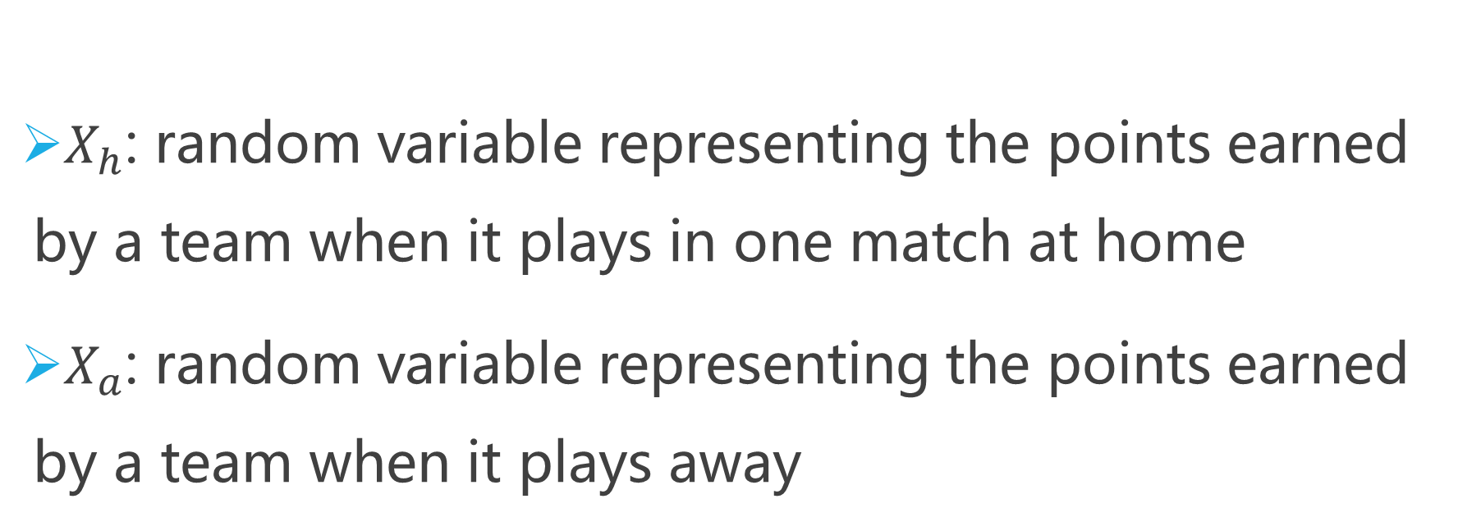
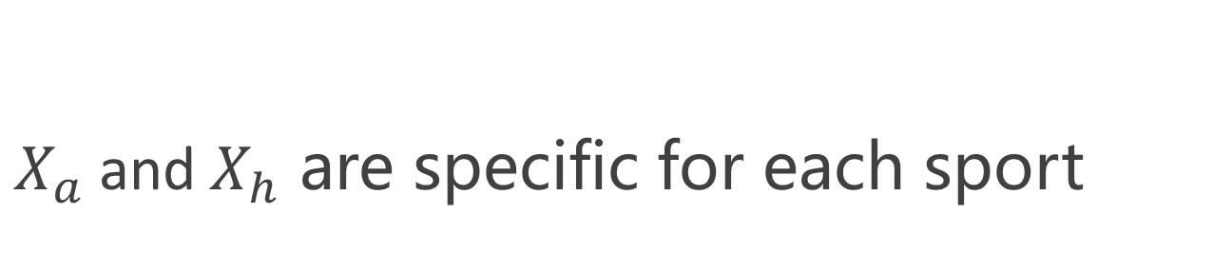
A luck and skill coefficient
$X_{h}$: random variable representing the points earned by a team when it plays in one match at home
$X_{a}$: random variable representing the points earned by a team when it plays away
$X_{a}$and$X_{h}$ are specific for each sport

